Slide 1

Getting the Money
15-<number>

Slide 2
The focus of this chapter is on several learning objectives
Real-world and electronic cash and their unique features and uses
The key requirements for Internet-based payments
The many ways people pay to purchase goods and services on the Internet
Business-to-business methods of payment
Paying for goods and services via the mobile phone
Issues and implications behind electronic money transactions and payments
15-<number>

Slide 3
Real-World Cash
Money
  Medium of exchange to simplify transactions
  Standard of value
  Store of value to facilitate the concept of saving
Cash continues to be the most widely used form of payment
  Convenience
  Wide acceptance
  Anonymity
  No cost of use
  No audit trail
15-<number>

Slide 4
Electronic Money (E-Money)
E-money is an electronic medium for making payments
  Credit cards
  Smart cards
  Debit cards
  Electronic funds transfer
Identified e-money (digital cash) is a notational money system that generates an audit trail and can be traced
Anonymous e-money is a notational money system that cannot be traced (like paper money)
15-<number>

Slide 5
Electronic Money (E-Money)
Online e-money each transaction is verified and approved by the issuing institute before payment is made
Offline e-money require no validation
Types of e-money
  Identified and online (+I+L) :
    Credit card transaction
  Identified and off-line (+I-L) :
    Travelers check, postal service money order
  Anonymous and online (-I+L) :
    Purchase using ATM card
  Anonymous and off-line (-I-L):
    Making deposit in ones account via ATM
15-<number>

Slide 6
Money Transfer
The ACID Test
  Atomicity
    Transaction must occur completely or not at all
  Consistency
    All party involve in the transaction must agree to the exchange.
  Isolation
    Each transaction must be independent of any other transaction
  Durability
    It must always be possible to reverse the last transaction
15-<number>

Slide 7
Money Transfer
The ICES Test
  Interoperability
    Ability to move back and forth between different system
  Conservation
    How well money holds it’s value over time
    How easy to store and access
  Economy
    How and affordable the transaction processing cost is
  Scalability
    Ability of the system to handle multiple user at the same time
15-<number>

Slide 8
Requirements for Internet-based Payments
Electronic payments are financial transactions made without the use of paper documents such as cash or checks
Internet-based Payment Systems Models
  Electronic currency is the network equivalent of cash
  Credit and debit cards are the electronic equivalent of checks
  Smart card is the microchip driven card with multipurpose use
15-<number>

Slide 9
Requirements for Internet-based Payments
Properties important to an electronic payment system:
  Acceptability
    Must be widely acceptable to merchants.
    Merchant must have technical ability and processes to expedite sales
  Ease of integration
    Should be easy to integrate with merchants web site
  Customer base
    Enough user are using the payment system
  Ease of use and ease of access
15-<number>

Slide 10
Electronic Transaction Systems
CyberCash
Netbill
Secure Electronic Transactions (SET)
15-<number>

Slide 11
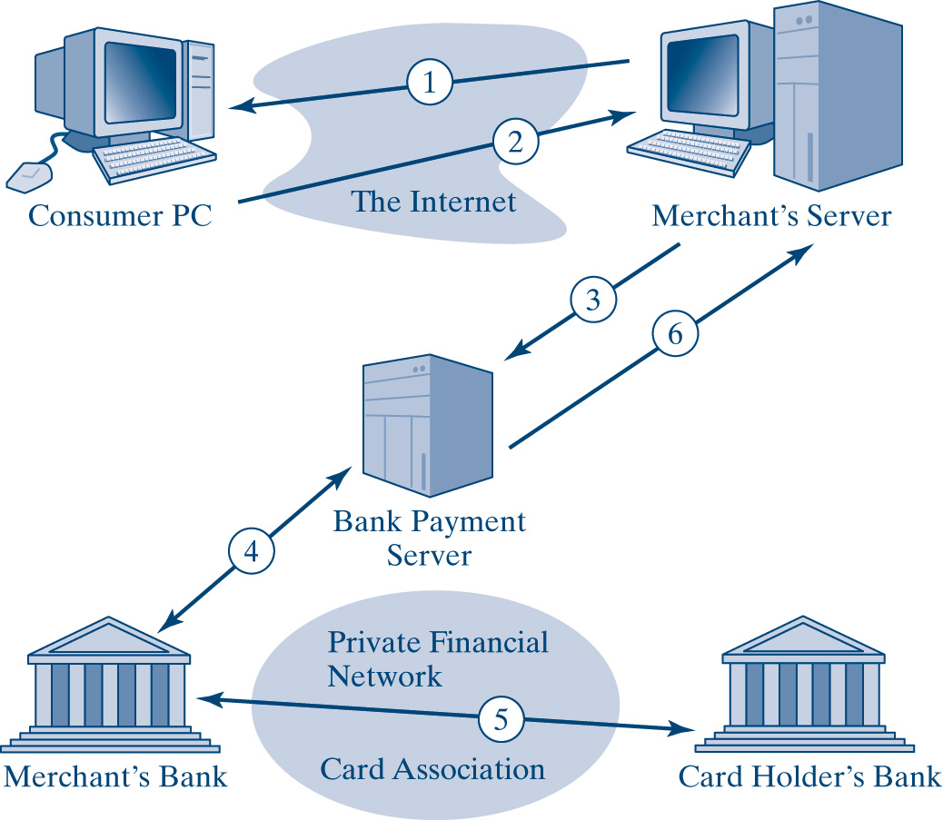
Secure Internet Credit Card Payment
15-<number>

Slide 12
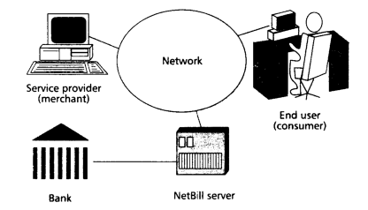
NetBill Payment System
~ is a economical payment system for purchasing digital goods
Netbill server maintain account for both customer and merchant.
Money tool is used to communicate between customer, merchants server and netbill server
15-<number>

Slide 13
How Would You Like to Pay?
Types of electronic payment media
  Trusted third-party type
  Notational fund transfer-related type
  Digital cash or electronic money
15-<number>

Slide 14
Paying with Credit Cards
A merchant must accept credit cards
You must first open a merchant account with your bank
Charges the merchant pays for online transactions are equivalent to the charges for phoning in the transaction
The Web merchant needs some form of secure and encrypted line, usually (SSL)
The merchant needs a shopping cart program that allows users to collect their purchases
15-<number>

Slide 15
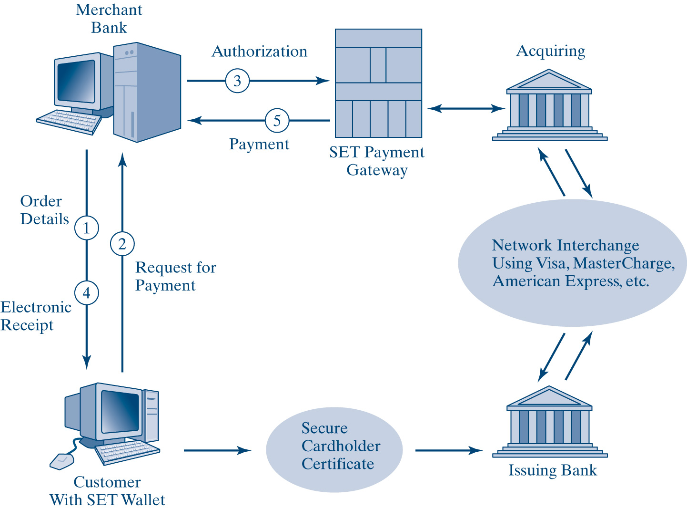
Classical Flow of a SET Transaction
15-<number>

Slide 16
15-<number>

Slide 17
how SET works:
The customer opens a Mastercard or Visa bank account.
The customer receives a digital certificate.
Third-party merchants also receive certificates from the bank.
The customer places an order over a Web page
The customer's browser receives and confirms from the merchant's certificate that the merchant is valid.
The browser sends the order information.
The merchant verifies the customer by checking the digital signature on the customer's certificate. This may be done by referring the certificate to the bank or to a third-party verifier.
The merchant sends the order message along to the bank.
The bank verifies the merchant and the message.
The bank digitally signs and sends authorization to the merchant, who can then fill the order.
15-<number>

Slide 18
Credit card laundering
~ is allowing a person, a business entity, or a corporation to use your own merchant account
It is a violation of merchant agreement with the bank and credit card company.
discovery by the bank or credit card company will result in termination, even if the processing company is reputable
15-<number>

Slide 19
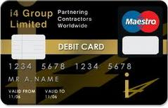
Debit card
15-<number>

Slide 20
Debit Cards
Look exactly like credits cards, except they directly tap your checking account every time you make a purchase or a withdrawal
Using a debit card frees you from having to carry cash or a checkbook
Debit cards are more readily accepted by merchants than are checks
It is generally easier to get a debit card than a credit card
15-<number>

Slide 21
Debit Cards (Cont’d)
Returned debit card purchases are treated just like returns for items purchased by cash or check
The debit card is a quick pay now process
Using a debit card may mean less protection for items that are never delivered, for defective items, or for items that were mis-represented
Cardholders might overspend their limit before anyone finds out
15-<number>

Slide 22
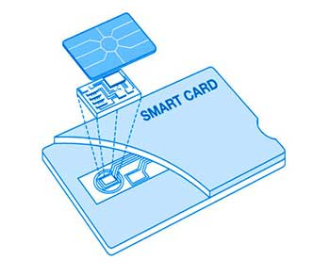
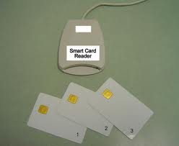
Smart Card
15-<number>

Slide 23
Smart Cards
Uses for Smart Cards
  Provides users with the ability to make a purchase
  Holds cash, ID information, and a key to a house or an office
  Three categories of applications
    Authenticate an individual’s claim of personal identification
    Authorization for things like drug prescription fulfillment and voting purposes
    Transaction processing
  Provides encryption and decryption of messages to ensure security, integrity, and confidentiality
  Acts as a carrier of value
15-<number>

Slide 24
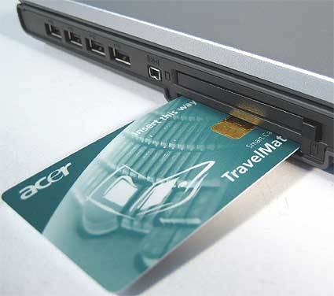
Smart Cash
15-<number>

Slide 25
Smart Card Applications
Government
Identification
Health care
Loyalty
Telecommunications
Transportation
Financial
15-<number>

Slide 26
DigiCash, E-Cash and E-Wallet
Digital cash leaves no audit trail
From a regulatory point of view, digital cash is not any different from any other kind of electronic financial payment medium
PayPal.com combines e-mail and the credit card network to send real cash
E-wallet is an electronic payment system that operates like a carrier of e-cash and information in the same way a real-world wallet functions
Amazon.com’s 1-Click system, http://www.Amazon.com
15-<number>

Slide 27
Electronic Funds Transfer and Automated Clearinghouse
Electronic fund transfer (EFT) is a computer-based system that facilitates the transfer of money or the processing of financial transactions between two financial institutions
Automated Clearinghouse (ACH) is where bank transactions, involving more than one institution, are routed to debit and credit the correct accounts
15-<number>

Slide 28
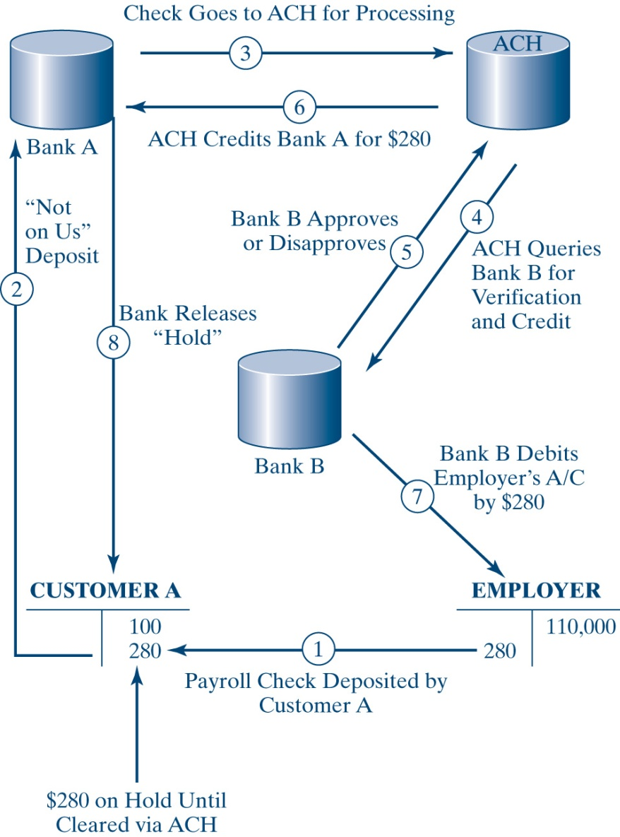
ACH - Generic Life Cycle of Check Clearance
15-<number>

Slide 29
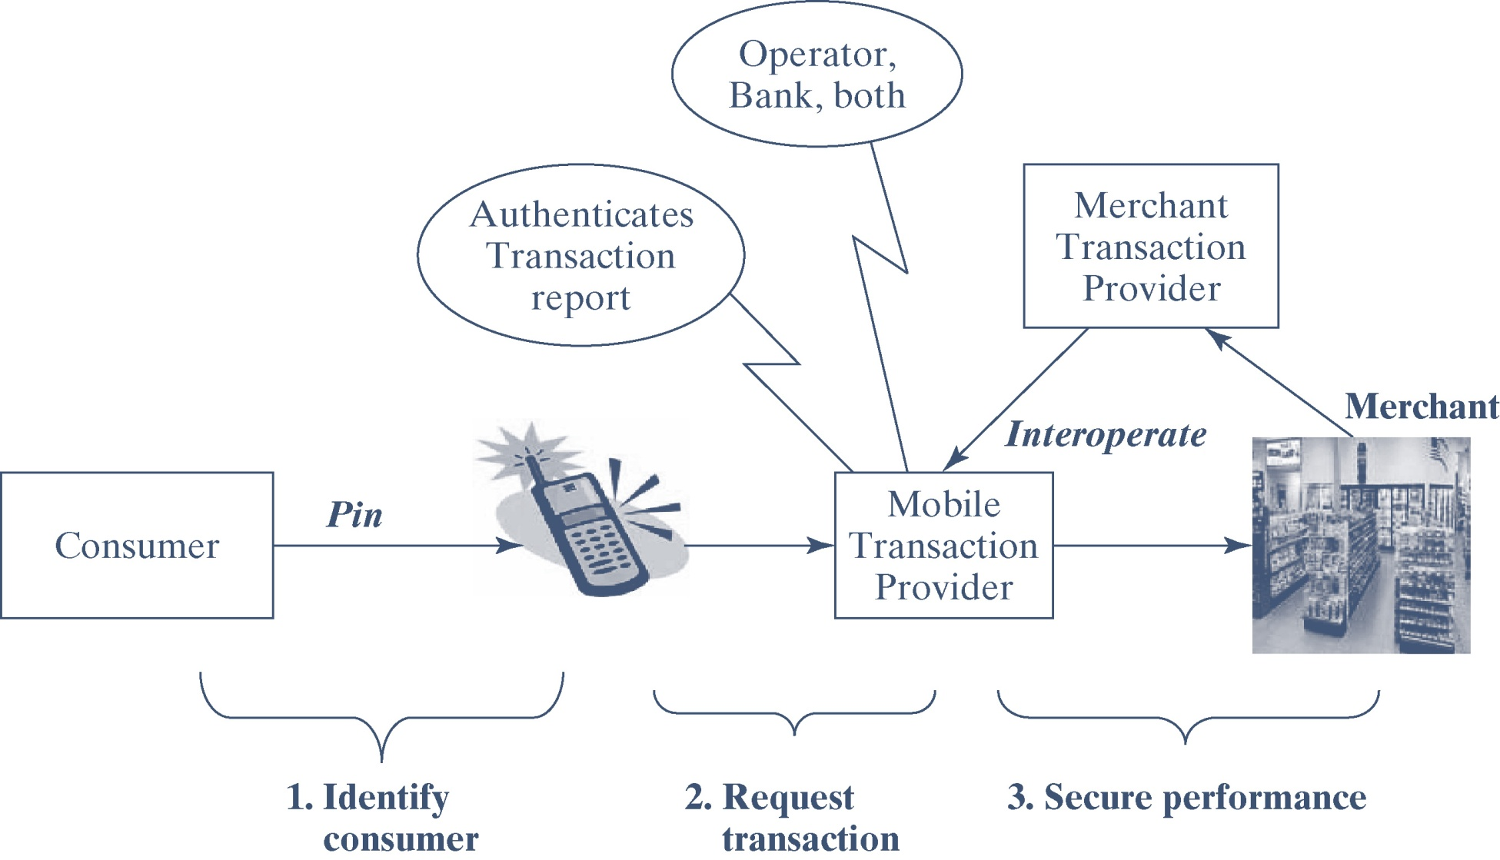
Mobile-specific
Transaction Architecture
15-<number>

Slide 30
General Guide to E-Payment
Use a secure Web browser
Read the Web site’s privacy policy carefully
Determine the merchant’s refund policies in advance of the final purchase
Investigate the trustworthiness of the merchant before you initiate a purchase
Keep a record of all online transactions and check e-mail and other contacts regularly
Review your credit card statements line-by-line to ensure authenticity
15-<number>

Slide 31
Issues Regarding Electronic Payment Methods and Methodologies
Consumer needs
Corporate processes
Corporate strategy
Regulation of competition
Economic and social processes
15-<number>

Slide 32
Chapter Summary
Cash offers unique features of convenience, wide acceptance, and no audit trail
Four types of e-money
  Identified and online
  Identified and off-line
  Anonymous and online
  Anonymous and off-line
There are two distinct sets of properties to consider in money transfer
  The ACID test
  The ICES test
15-<number>

Slide 33
Chapter Summary (Cont’d)
Electronic currency, credit cards, debit cards, and smart cards are the four main models for Internet-based payment systems
Payment systems via the Internet include CyberCash and First Virtual
Secure Electronic Transactions (SET) is a standard for handling transactions on the Internet
There are three types of electronic payment media
  Trusted third party
  Notational fund transfer-related type
  Digital cash or electronic money
15-<number>

Slide 34
Chapter Summary (Cont’d)
A smart card is a card with a built-in chip capable of storing information in its memory
One alternative method of payment is digital cash
EFT is a computer-based system that facilitates the electronic transfer of money or the processing of financial transactions between financial institutions
Cryptography is the future of privacy and represents the future of money, banking, and finance
15-<number>

